Slide 1

Lightning Presentation
Jacek Slowikowski

Slide 2
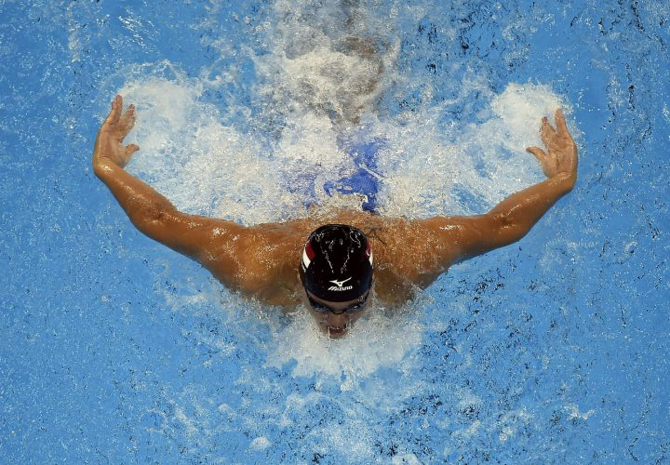
Swimming
Will a swimmer know if their training is going to pay off with a top-8 finish in the NCAA championships before going into competition? Top bracket is usually known, can we predict the rising stars?
AIM
Using NCAA swim meet data from 2013-2017 to analyze intra-year performance and end-of-season (pre-championship) collegiate rankings of individual swimmers will help predict the chance of a swimmer making it into the top 8 at NCAA Championships for the Men’s 100 Fly in 2018
Data Source(s)
Swim meet record information from USASwimming.org
College Team sites host meet info
ONLY colleges with swimmers who have attended NCAAs in the past 4 years
Pros:
Well-kept data
Athletes have highly regimented lifestyle and competition approach (so may be generalizable)
Cons:
Individual Meet performance differs greatly on a number of factors. Need to find a variable that could be applied across the spectrum
Variable is likely some factor of : Difference from American record, Variability from previous races, etc

Slide 3

Electronic Music
Producing music is a lot of fun. How seriously should one entertain the notion that it might take you anywhere? (something like 3000 songs per week uploaded to beatport)
AIM Using descriptive characteristics of the top 100 electronic-music hits by genre in 2017 one will be able to determine the probability that a song makes it into the top 100 of most watched/listened to songs on YouTube/Soundcloud/Spotify?
Pros:
Fun topic. Hobby of mine.
Lots of mainstream pickup lately. Multiple data sources may help to predict popularity (billboard, youtube, soundcloud, etc)
Cons:
Very hard to answer due to many factors, including the subjectivity of music
Many different sources of data. Not all are retrieval friendly
Potentially too hard to answer
Confounding variables (views/listens are not necessarily unique or truly human!
Notes:
Popularity gradient is specific to genre. Can we track which songs have the potential to break it into the mainstream?
Is top charting electronic music getting subjectively boring?
Similar bpm
Similar key
Main genres
http://remixrotation.com/best-of-2017.html
By key, by bpm, predict views on youtube for top songs?
Anticipated problems – Viewer bots

Slide 4

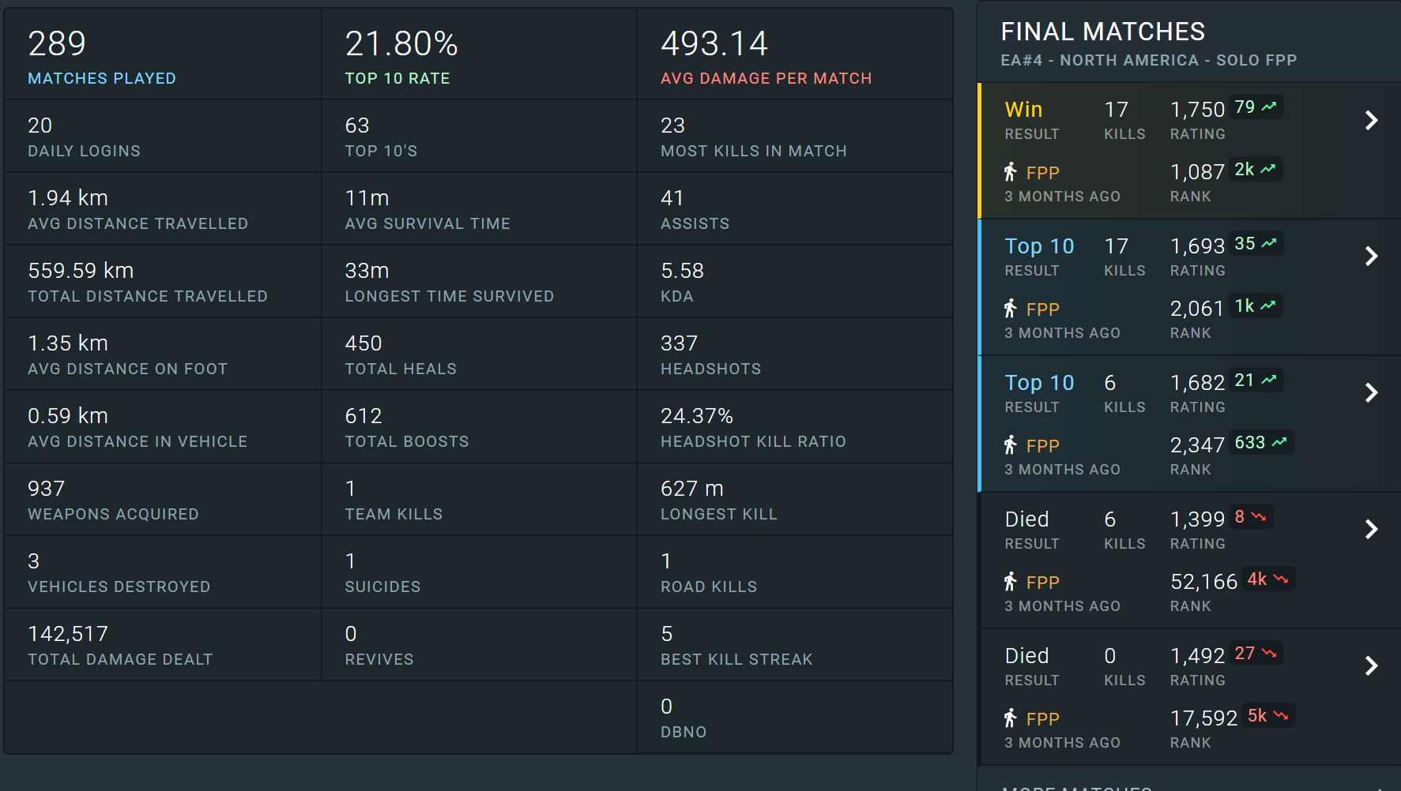
PlayerUnkown Data
Somewhere out there a hard working guy/gal needs an hour to blow off steam. Given your playstyle, is playing 2 rounds of PUBG worth it?
AIM
Using data from 3 months of player data from approximately 100,000 unique players and 1MM hours of gameplay will help me predict whether or not my play style gives me a good chance of winning a match (or two) if I only have 1hr of downtime a day. (2 Rounds takes approx. 1hr)
Pros:
Massive amount of data (150 game-play features per player)
Constantly growing
Ease of access (API!) – Responsive Team
Cons:
Data set is not indicative of full population
Cheaters
Game is in Beta and always changing so may not have long-term generalizability
Notes:
Predict who will win a match
Style of play
Amount of time playing
Age of player
Shots fired
Average survival
Winning circle quadrant
KDR
https://www.kaggle.com/lazyjustin/pubgplayerstats

